Slide 1

Basic Details of the Team and Problem Statement
Ministry/Organization Name/Student Innovation:
Government of Jammu and Kashmir
PS Code: SIH1355
Problem Statement Title: Developing solutions to effective market linkage and promotion of One District One Product.
Team Name: BAZINGAA
Team Leader Name: HIMANCHAL KHATTRI
Institute Code (AISHE): U-0643
Institute Name: GALGOTIAS UNIVERSITY
Theme Name: Heritage & Culture

Slide 2

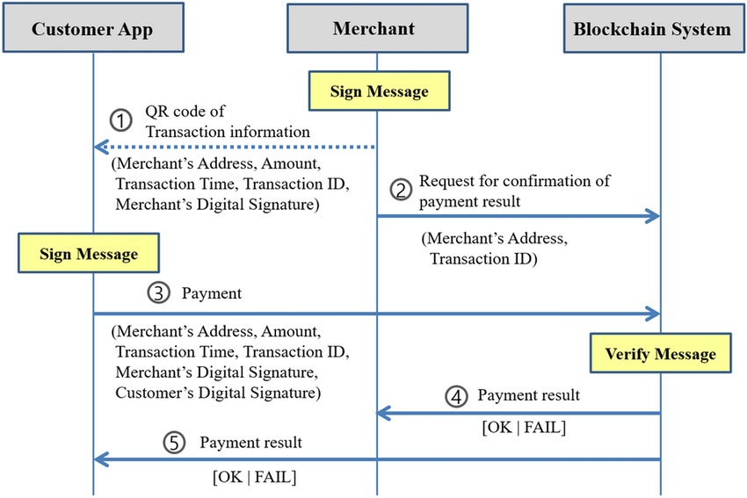



















Idea/Approach Details
Describe your idea/Solution :
We’re here for a solution by creating an android and web-based portals that will serve as a platform for local artisan , vendors and craftsmen to showcase their rich cultures and traditions under the scheme of ODOP , to promote local startups and boost rural and small-scale industries. The Prototype will function as follows :
Users, including artisans, producers, buyers, and government officials, can register on the platform. KYC verification is performed to ensure the authenticity of users.
Artisans and producers from different districts of Jammu and Kashmir can select their respective district and the specific product they want to promote under the ODOP scheme.
The core of the platform relies on Blockchain technology for data security and transparency.
Registered artisans and producers can list their products on the platform, including product details, images, pricing, and production capacity .
The platform includes an e-commerce marketplace where buyers, both domestic and international, can browse and purchase ODOP products.
Blockchain records and verifies eligibility criteria, simplifying the application process.
The platform’s algorithm provides insights into market trends, demand, and supply patterns, helping artisans make informed decisions.
Buyers can leave reviews and feedback; this feedback loop helps artisans improve their products and build trust with consumers.
Government officials have access to real-time data on the platform, enabling them to monitor the progress of the ODOP scheme effectively.
Technology stack :

Slide 3
Idea/Approach Details
Use Cases
Showstopper’s
When the local products of each districts gets registered on the platform , awareness will spread about the rich culture and heritage of every unique Districts .
Buyers, both domestic and international, can explore and purchase ODOP products.
The platform supports rural artisans and small-scale industries, helping them grow and contribute to the local economy.
Promoting ODOP products through the platform encourages sustainable, eco-friendly production practices and products often reflect the cultural heritage of a region .
The platform can highlight and preserve these cultural elements.
All of this help reducing unemployment figures .
Secure and transparent payment processing using blockchain technology ensures that transactions are tamper proof and trustworthy .
By using ml algorithm , trends can be sorted, and it will be helpful for the manufacturers to keep track of their inventory .
An AI chatbot can also be integrated to assist the users in case of any case assistance 24/7 .
Regional and other official languages can also be added .
An API using google maps to make platform more responsive can also be used .
Mobile-Friendly and User-Friendly Interface. By ensuring that the platform is accessible and easy to navigate on mobile devices, catering to a wider audience.

Slide 4
Team Member Details
Team Leader Name: Himanchal Khattri
Branch : Btech Stream : CSE Year : II
Team Member 1 Name: Anmol Sharma
Branch : Btech Stream : CSE Year : II
Team Member 2 Name: Ayush Abhishek Gupta
Branch : Btech Stream : CSE Year : II
Team Member 3 Name: Lalit Chaudhary
Branch : Btech Stream : CSE Year : II
Team Member 4 Name: Neha Kushwaha
Branch : Btech Stream : CSE Year : II
Team Member 5 Name: Utkarsh Bhola
Branch : Btech Stream : CSE Year : II
Team Mentor 1 Name: Type Your Name Here
Category (Academic/Industry): Expertise (AI/ML/Blockchain etc): Domain Experience (in years):
Team Mentor 2 Name: Type Your Name Here
Category (Academic/Industry): Expertise (AI/ML/Blockchain etc): Domain Experience (in years):

